Slide 1


Lempel-Ziv Compression
EE539: Principles of Information Theory and Coding

Slide 2
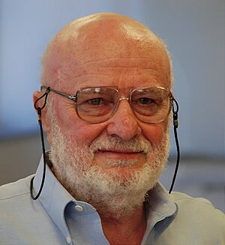
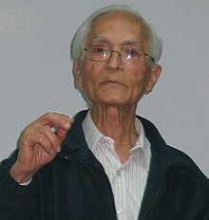

Lempel-Ziv Algorithm : A Brief History
Abraham Lempel (10 February 1936 – 4 February 2023) was an Israeli computer scientist and one of the fathers of the LZ family of lossless data compression algorithms.
Jacob Ziv (27 November 1931 – 25 March 2023) was an Israeli electrical engineer and information theorist who developed the LZ family of lossless data compression algorithms alongside Abraham Lempel.

Slide 3
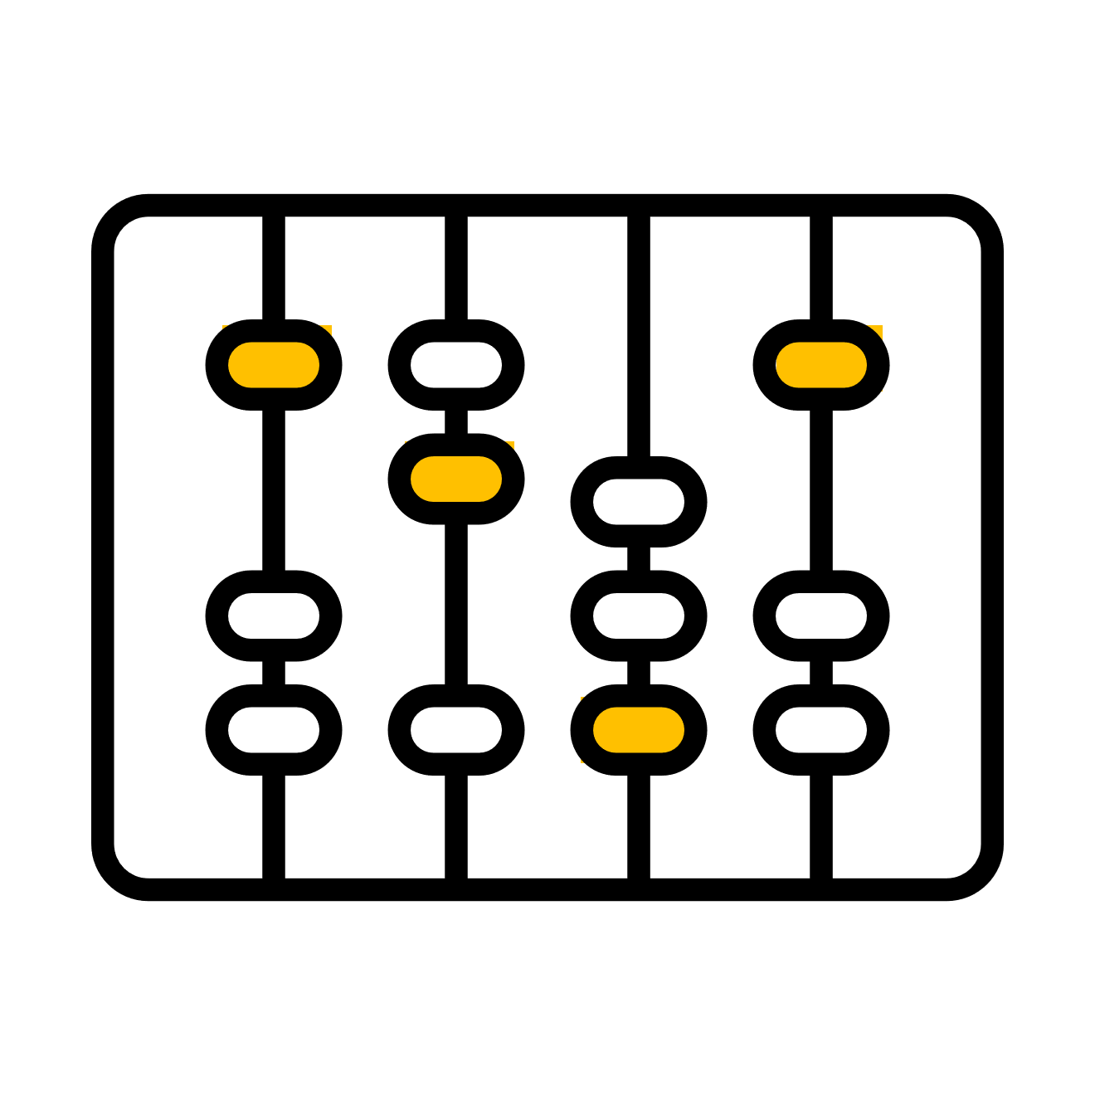
Lempel-Ziv Algorithm : An Introduction
LZ77 and LZ78 are the two lossless data compression algorithms published in papers by Abraham Lempel and Jacob Ziv in 1977 and 1978. Besides their academic influence, these algorithms formed the basis of several ubiquitous compression schemes, including GIF and the DEFLATE algorithm used in PNG and ZIP.
They are both theoretically dictionary coders. LZ77 maintains a sliding window during compression. This was later shown to be equivalent to the explicit dictionary constructed by LZ78—however, they are only equivalent when the entire data is intended to be decompressed.
Since LZ77 encodes and decodes from a sliding window over previously seen characters, decompression must always start at the beginning of the input. Conceptually, LZ78 decompression could allow random access to the input if the entire dictionary were known in advance. However, in practice the dictionary is created during encoding and decoding by creating a new phrase whenever a token is output.
The algorithms were named an IEEE Milestone in 2004. In 2021 Jacob Ziv was awarded the IEEE Medal of Honor for his involvement in their development.

Slide 4
Lempel-Ziv Algorithm : An Understanding
In Lempel-Ziv compression algorithm, the idea is that if some text is not random, a substring that has already been encountered is more likely to reoccur than those we haven't observed yet.
The LZ78 algorithm builds a dictionary of substrings, referred to as “phrases,” that have appeared in the text.
This algorithm creates its dictionary dynamically, processing the data in a single pass.
This feature is particularly beneficial because it allows us to begin encoding without needing to have the full document beforehand.

Slide 5
Lempel-Ziv Algorithm : Rules of Implementation
Rules to apply LZ algorithm:
The first step in applying LZ algorithm is to divide the given text into segments.
These segments should be the shortest segments, not encountered previously. All these segments are referred as “Phrase”.
We assign a unique incremental index to each Phrase we encounter while traversing through the text.
We encode each phrase by prefix index and last bit.
We convert the assigned code for each Phrase into its binary value.
The binary conversion consists of 2 parts,
the first part is the prefix index code – we convert the numerical index to its binary value.
the second part is the last bit – we can convert the last bit in multiple ways :
If the number of unique characters are less, we can assume a mapping and share the same mapping dictionary with the decoder.
If the frequencies of unique letters are known , we could even use a Huffman code to encode the letters.
If the number of unique characters are known, we can use the universal ASCII conversion, which the decoder will also have.

Slide 6
Example 1 - Segmentation
The given input string:
AAAAAAAAABAAACAABAAC
We start with the shortest phrase on the left that we haven’t encountered before. This will always be a single letter, in this case A:
A | AAAAAAAABAAACAABAAC
We now take the next phrase we haven’t come across. We’ve already seen A, so now we take AA:
A | AA | AAAAAABAAACAABAAC
The next phrase we haven’t encountered is AAA, as we’ve already seen AA. We continue further, we get AAAB:
A | AA | AAA | AAAB | AAACAABAAC
and we finally get the segmented text:
A | AA | AAA | AAAB | AAAC | AAB | AAC

Slide 7
Example 1 - Encoding
Now, we need to encode the segmented text. For each phrase we see, we prepare a dictionary of indexes. The next time we want to send it, we don’t send the entire phrase, but just the index of this phrase. Consider the following tabular notation, in which the first row gives the index of the phrase, the second row represents the phrases, and the third row their encodings:
1 2 3 4 5 6 7
A | AA | AAA | AAAB | AAAC | AAB | AAC
∅A 1A 2A 3B 3C 2B 2C
For instance, when we’re encoding the segment AAAB (the 4th phrase), we encode it as 3B. This maps to AAAB since the 3rd phrase was AAA, and we add B to it.
Here, the empty set ∅ should be considered as the 0’th phrase and encoded by 0.

Slide 8
Example 1 - Binary conversion
A | AA | AAA | AAAB | AAAC | AAB | AAC
∅A 1A 2A 3B 3C 2B 2C
Now, we convert each encoding symbol into its binary notations. In this example, I have mapped A to 0, B to 1 and C to 10:
0, 0 | 1, 0 | 10, 0 | 11, 1 | 11, 10 | 10, 1 | 10, 10
Finally, the Binary representation of the encoding looks like:
001010011111101011010

Slide 9
Example 2 - Segmentation
The given input string:
ABBABBABBAABBAAABBAAAA
We start with the shortest phrase on the left that we haven’t encountered before. This will always be a single letter, in this case A:
A | BBABBABBAABBAAABBAAA
We now take the next phrase we haven’t come across. We’ve already seen A, so now we take B:
A | B | BABBABBAABBAAABBAAAA
The next phrase we haven’t encountered is BA, as we’ve already seen B. We continue further, we get BB after that:
A | B | BA | BB | ABBAABBAAABBAAAA
and we finally get the segmented text:
A | B | BA | BB | AB | BAA | BBA | AA | BBAA | AA

Slide 10
Example 2 - Encoding
Now, we need to encode the segmented text. For each phrase we see, we prepare a dictionary of indexes. The next time we want to send it, we don’t send the entire phrase, but just the index of this phrase. Consider the following tabular notation, in which the first row gives the index of the phrase, the second row represents the phrases, and the third row their encodings:
1 2 3 4 5 6 7 8 9 10
A | B | BA | BB | AB | BAA | BBA | AA | BBAA | AA
∅A ∅B 2A 2B 1B 3A 4A 1A 7A 8
For instance, when we’re encoding the segment BBA (the 7th phrase), we encode it as 4A. This maps to BBA since the 4th phrase was BB, and we add A to it.
Here, the empty set ∅ should be considered as the 0’th phrase and encoded by 0.
The last phrase AA at index 10 is same as at index 8, so we don’t need any symbolic representation to denote it. We just consider the previously encountered index value.

Slide 11
Example 2 - Binary conversion
A | B | BA | BB | AB | BAA | BBA | AA | BBAA | AA
∅A ∅B 2A 2B 1B 3A 4A 1A 7A 8
Now, we convert each encoding symbol into its binary notations. In this example, I have mapped A to 0 and B to 1:
0, 0 | 0, 1 | 10, 0 | 10, 1 | 1, 1 | 11, 0 | 100, 0 | 1, 0 | 111, 0 | 1000
Finally, the Binary representation of the encoding looks like:
00011001011111010001011101000

Slide 12
Thank You

